Slide 1
introduction to python
GIS in the Rockies
By Luke Kaim Thelen
lucaskaimthelen@gmail.com
09/16/2019

Slide 2
Useful links and resources
Python
PennState GEOG 485 - GIS Programming and Automation
Learning Python the Hard Way
tutorials point
https://geonet.esri.com/community/discussions-lobby/overview
GIS Colorado listserv (list@giscolorado.org )
Stack Exchange http://stackexchange.com/sites
http://gis.stackexchange.com/
http://stackoverflow.com/
http://www.meetup.com/Geospatial-Amateurs-Denver/
http://www.diveintopython.net/toc/index.html
Google
https://www.youtube.com/channel/UCjGzNLUkTOFzWdD_5MzNIqg/feed
Use your network. “How do you get people to help you? You can’t get there alone. People have to help you and I do believe in karma. I believe in paybacks. You get people to help you by telling the truth. Being earnest. I’ll take an earnest person over a hip person any day, because hip is short term. Earnest is long term.” (Randy Pausch)

Slide 3
Introduction
Python is an object-oriented programming language.
Everything is an object.
Python is very flexible because of this fact.

Slide 4
Python basics
Python is case sensitive
Python is white space insensitive. Python will skip comment lines.
Python uses indention to form blocks of code. Other programming languages use braces like Java.
One should not go over 80 characters when writing python code. This is for readability.
Test code as you go. Do not wait until you are done to debug code. Test code often. One of the best ways to debug code is to add print statements.
Do not be afraid to make mistakes. This is how we learn. Never assume the black box is coded correctly.

Slide 5
Update a feature class
How can we update an attribute value in a feature class? I can think of at least 4 methods to update a value in a feature class. Can you come up with the methods?
Curiosity is critical to programming. Always try to understand how the code works.
In programing there are many different methods to solve the problem. It is important to understand those methods and choose a solution.
os.walk and os.listdir can be used to solve the same problem. There are many different ways to solve the problem. Never be afraid to test different solutions. This is how we learn.
Notes:
1. Manually
2. Export to excel and update the dbf
3. Select and field calculator
4. updatecursor.

Slide 6
Things to keep in mind
Always understand the problem one is trying to solve. Have a plan!!
One would be surprised at how many times people lose sight of the original problem one set out to solve.
It is okay to change the plan because one realizes they have over looked some logic that now has to be added, but you have to have a plan in order to change the plan.
Always create pseudocode and test the steps manually before starting coding. Test the workflow logic before starting coding and make sure the workflow actually answers the question.
Ensures that the code is efficiently written
Writing good clean code the first time is always faster than having to rewrite code later.
When coding avoid hardcoding
Field names change, filenames change

Slide 7
Things to keep in mind
“It ain’t so much the things we don’t know that get us in trouble. It’s the things we know that ain’t so.” (Artemus Ward)
How many sides does a raster cell have?
Which map would show more area a large scale map or a small scale map?

Slide 8
Comment code and test
Always comment code. Code is not complete unless it is commented. Use docstrings and inline comments
When coding in Python 90 percent of your time will be spent reading code and 10 percent of your time will be spent writing code. That is why documenting your code is so important
Commenting as you code is faster and easier then commenting at the end
Documenting code is a way of telling other programmers what you did and why

Slide 9
Do not ever duplicate code
Don't repeat yourself (DRY)
“The computing scientist’s main challenge is not to get confused by the complexities of his own making”(E. W. Dijkstra)
“One of my most productive days was throwing away 1000 lines of code” (Ken Thompson)
“Deleted code is debugged code” (Jeff Sickel)
“Every methodology I’ve come across has, at its kernel, a very small section labelled “do magic here” (Katie)
“Everything should be made as simple as possible, but no simpler.” or “Make things as simple as possible, but not simpler”(Albert Einstein)

Slide 10
Python data types overview
Numbers (int, float, double, long)
String - are text defined between quotes either single or double quotes
List is a comma-separated values between brackets
Tuple is a sequence of immutable python objects
Sets is a collection of unique elements
Dictionary stores keys and values. Values can be looked up using the key. Think of the key as a primary key in a database. Keys have to be unique

Slide 11
Python reserved words
Keywords = [and, del, from, not, while, as, elif, global, or, with, assert, else, if, pass, yield, break, except, import, print, class, exec, in, raise, continue, finally, is, return, def, for, lambda, try]
Backslash allows one to escape.

Slide 12
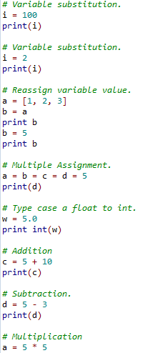
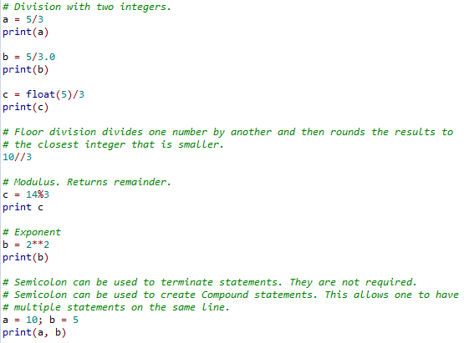
Numbers
Notes:
# Variable substitution.
i = 100
print(i)
# Variable substitution.
i = 2
print(i)
# Multiple Assignment.
a = b = c = d = 5
print(d)
# Type case a float to int.
w = 5.0
print int(w)
# Addition
c = 5 + 10
print(c)
# Subtraction.
d = 5 - 3
print(d)
# Multiplication
a = 5 * 5
# Division.
a = 5/3
print(a)
b = 5/3.0
print(b)
c = float(5)/3
print(c)
# Floor division divides one number by another and then rounds the results to
# the closest integer that is smaller.
10//3
# Modulus. Returns remainder.
c = 14%3
print c
# Exponent
b = 2**2
print(b)

Slide 13
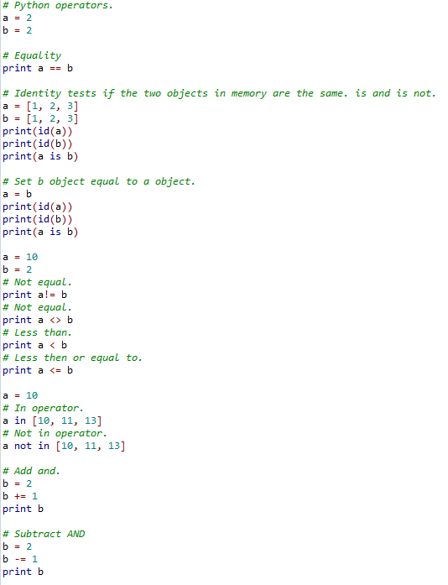
Python Operators
http://www.tutorialspoint.com/python/python_basic_operators.htm

Slide 14
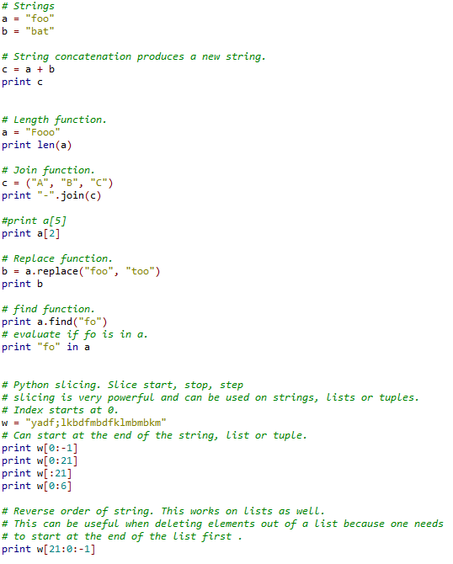
String
https://docs.python.org/2/library/stdtypes.html#string-methods
http://www.dotnetperls.com/slice-python
Notes:
# Strings
a = "foo"
b = "bat"
# String concatenation produces a new string.
c = a + b
print c
# Length function.
a = "Fooo"
print len(a)
# Join function.
c = ("A", "B", "C")
print "-".join(c)
#print a[5]
print a[2]
# Replace function.
b = a.replace("foo", "too")
print b
# find function.
print a.find("fo")
# evaluate if fo is in a.
print "fo" in a
# Python slicing. Slice start, stop, step
# slicing is very powerful and can be used on strings, lists or tuples.
# Index starts at 0.
w = "yadf;lkbdfmbdfklmbmbkm"
# Can start at the end of the string, list or tuple.
print w[0:-1]
print w[0:21]
print w[:21]
print w[0:6]
# Reverse order of string. This works on lists as well.
# This can be useful when deleting elements out of a list because one needs
# to start at the end of the list first .
print w[21:0:-1]

Slide 15
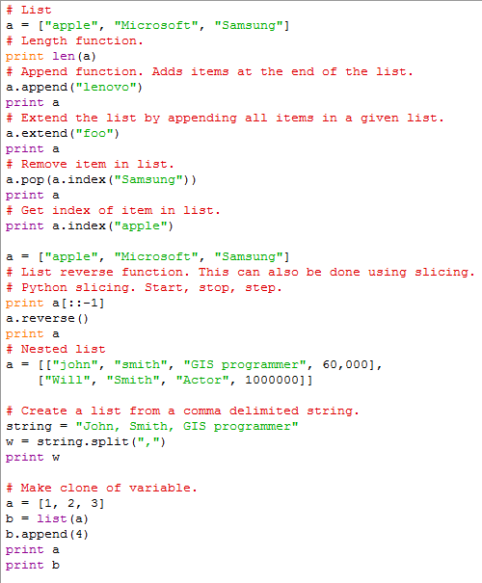
Lists
https://docs.python.org/2/tutorial/datastructures.html
Notes:
# List
a = ["apple", "Microsoft", "Samsung"]
# Length function.
print len(a)
# Append function. Adds items at the end of the list.
a.append("lenovo")
print a
# Extend the list by appending all items in a given list.
a.extend("foo")
print a
# Remove item in list.
a.pop(a.index("Samsung"))
print a
# Get index of item in list.
print a.index("apple")
a = ["apple", "Microsoft", "Samsung"]
# List reverse function. This can also be done using slicing.
a.reverse()
print a
# Nested list
a = [["john", "smith", "GIS programmer", 60,000],
["Will", "Smith", "Actor", 1000000]]
# Create a list from a comma delimited string.
string = "John, Smith, GIS programmer"
w = string.split(",")
print w

Slide 16
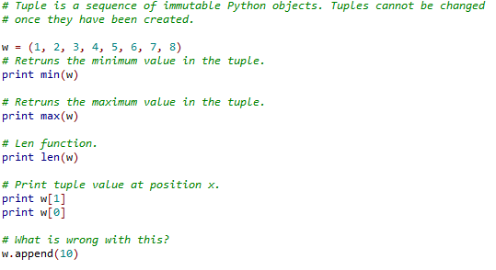
Tuple
http://www.tutorialspoint.com/python/python_tuples.htm

Slide 17
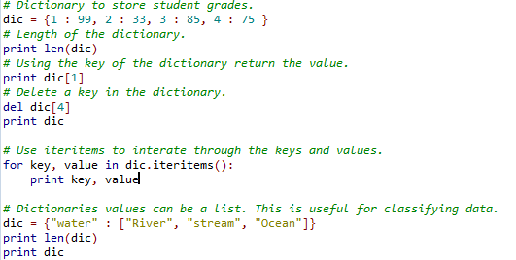
Dictionary
https://docs.python.org/2/library/stdtypes.html#typesmapping
Order does not matter in a dictionary

Slide 18
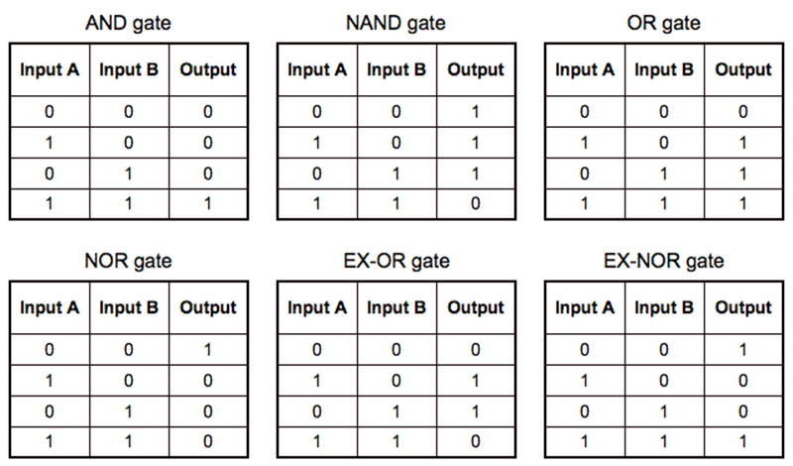
Truth Table

Slide 19
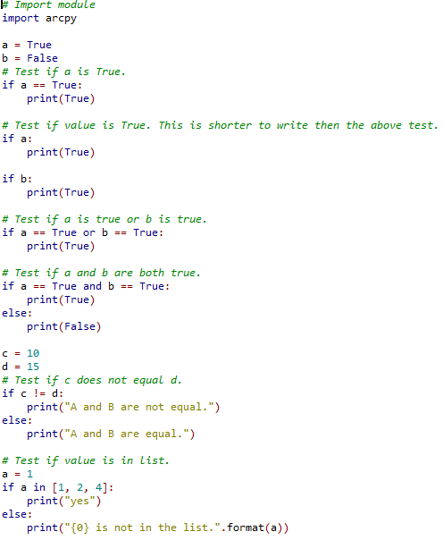
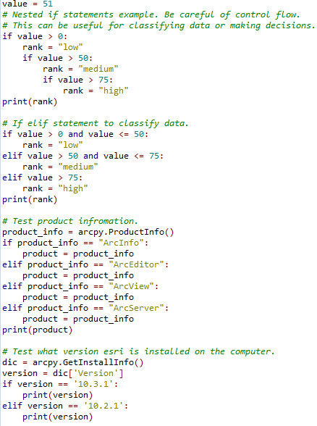
If else Boolean logic Control flow
Boolean logic using if else logic is a way of making decisions with code

Slide 20
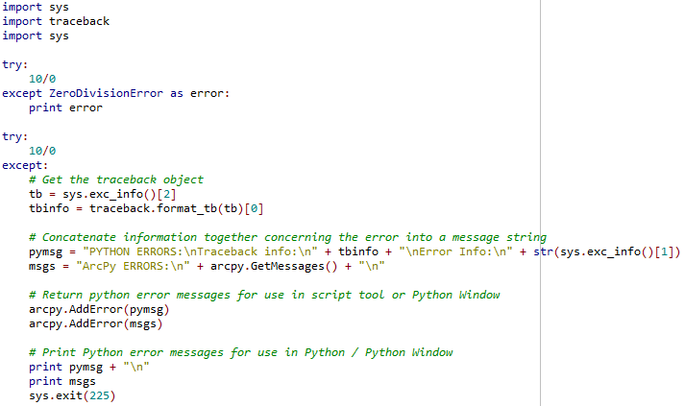
Error Handling
An exception is an error that happens during the execution of a program.
Notes:
http://www.python-course.eu/exception_handling.php

Slide 21
Exercise 1
Create code to test if a feature class exists or not.
If the file does not exist then print message.
If the file exists then test the features shape type. If the shape type is not a point, line or polygon, then print message stating the user must select a new file. If the shape type is point, line or polygon, then print the shape type.
https://pro.arcgis.com/en/pro-app/arcpy/functions/featureclass-properties.htm

Slide 22
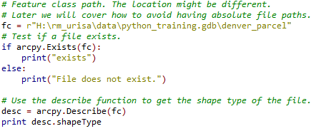
Exercise 1
Expand the logic to handle if a feature class exists and test the shape type of a feature class.

Slide 23
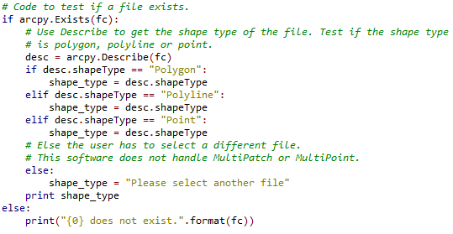
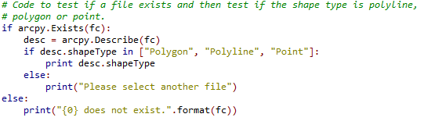
Exercise 1 Answer
Both answers are technically correct. Why is one answer better then another?

Slide 24
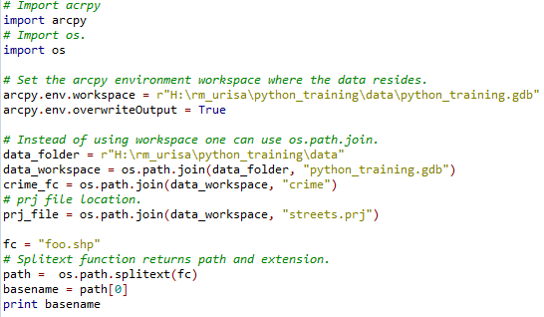
File path locations

Slide 25
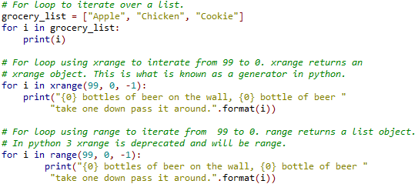
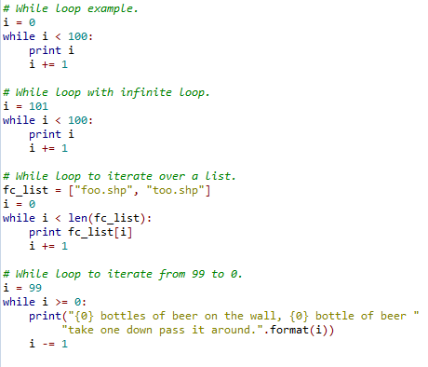
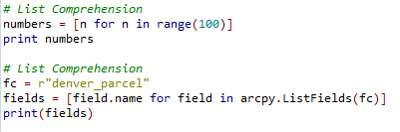
Loops
Loops allow one to iterate over a group of statements multiple times
For loop
While loop
Notes:
http://psung.blogspot.com/2007/12/for-else-in-python.html

Slide 26
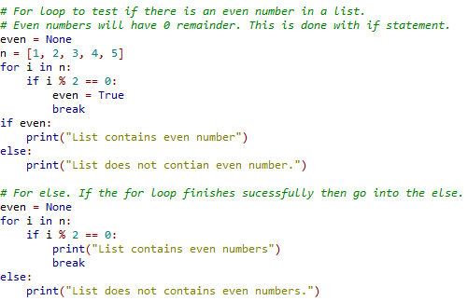
Loops: For else
For else tests if the loop finishes. This can be useful because sometimes one wants to know if the loop finishes or not.

Slide 27
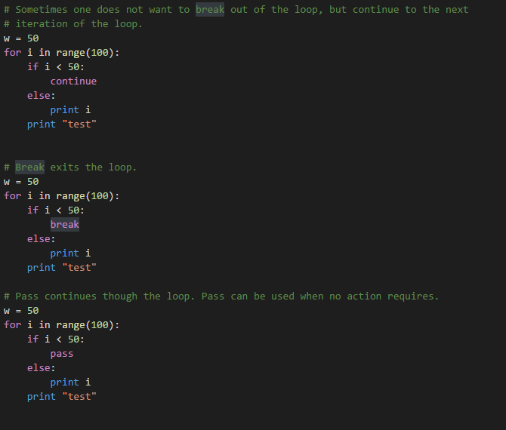
Continue

Slide 28
Exercise 2
Use a for loop or while loop to iterate over a list
Test if the feature class exists
Project the data to State plane north
If the feature class is a point feature class, then buffer each point by 50 feet
If the feature class is a line feature class, then buffer the line by 100 feet
If the feature class is a polygon feature class, then buffer the polygon by 200 feet
Code must be commented.
Hint combine the code from exercise 1.
arcpy.Buffer_analysis(in_features="roads", out_feature_class="C:/output/majorrdsBuffered", buffer_distance_or_field="100 Feet", line_side="FULL", line_end_type="ROUND", dissolve_option="LIST", dissolve_field="Distance", method=None)
https://pro.arcgis.com/en/pro-app/tool-reference/analysis/buffer.htm
https://pro.arcgis.com/en/pro-app/tool-reference/data-management/project.htm
Notes:
https://desktop.arcgis.com/en/desktop/latest/tools/analysis-toolbox/buffer.htm

Slide 29

Exercise 2

Slide 30
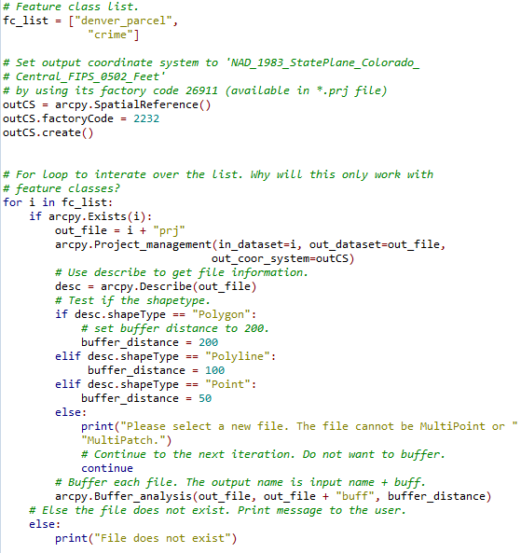
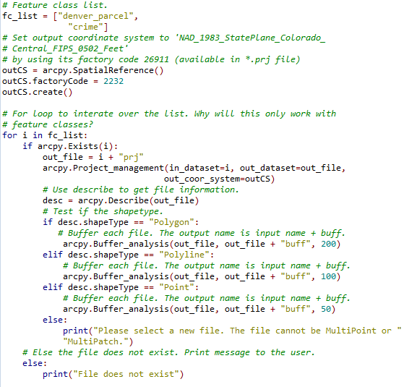
Exercise 2 Answer

Slide 31
Functions
Functions are organized blocks of code that are used to preform a single action. Functions allow code to be reused. We have already called functions. Now we will learn more about functions and how to create user-defined functions.
When dealing with function variable scope is very important. Variables within functions are local. Variable outside of functions are global. This is a very important concept because one does not want another function to be able to modify that variable.
This is known as encapsulation. Generally speaking encapsulation is the mechanism for restricting the access to some of an object's components.
Notes:
http://www.python-course.eu/object_oriented_programming.php

Slide 32
Functions
Functions can be imported into other scripts. This prevents having the same logic in every script. If we had an error function and we had that function in every script that would be bad design if that function ever changes, then one would have to update it in every script
We will now go through how to import a user-defined function.

Slide 33
Exercise 3
Take exercise two and modify the code to create a function with two parameters. The first parameter should be an input list. The second parameter should be the projection code.
Call the function
Bonus points if you write the files to a different workspace.

Slide 34
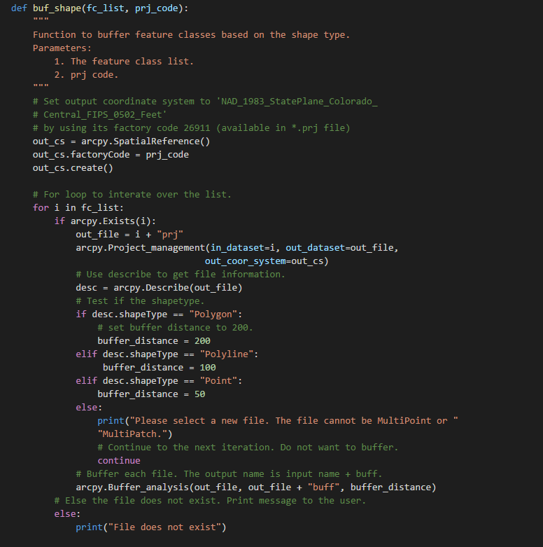
Function answer

Slide 35
Classes
Simply a logical grouping of data and functions (the latter of which are frequently referred to as "methods" when defined within a class).
Classes allow one to create their own data containers and model the real world.
One could model vehicles (SUV, sedan, truck, and bike) or bank accounts with classes. With vehicles each type has special attributes.
Classes can be thought of as blueprints for creating objects
http://www.python-course.eu/python3_multiple_inheritance.php
http://hplgit.github.io/primer.html/doc/pub/class/._class-readable002.html
https://code.tutsplus.com/articles/python-from-scratch-object-oriented-programming--net-21476

Slide 36
Esri cursor
Cursors allow you to iterate over rows in a shapefile or feature class.
There are three types of cursors (search, update, insert)
https://pro.arcgis.com/en/pro-app/arcpy/get-started/data-access-using-cursors.htm
https://pro.arcgis.com/en/pro-app/arcpy/functions/searchcursor.htm

Slide 37
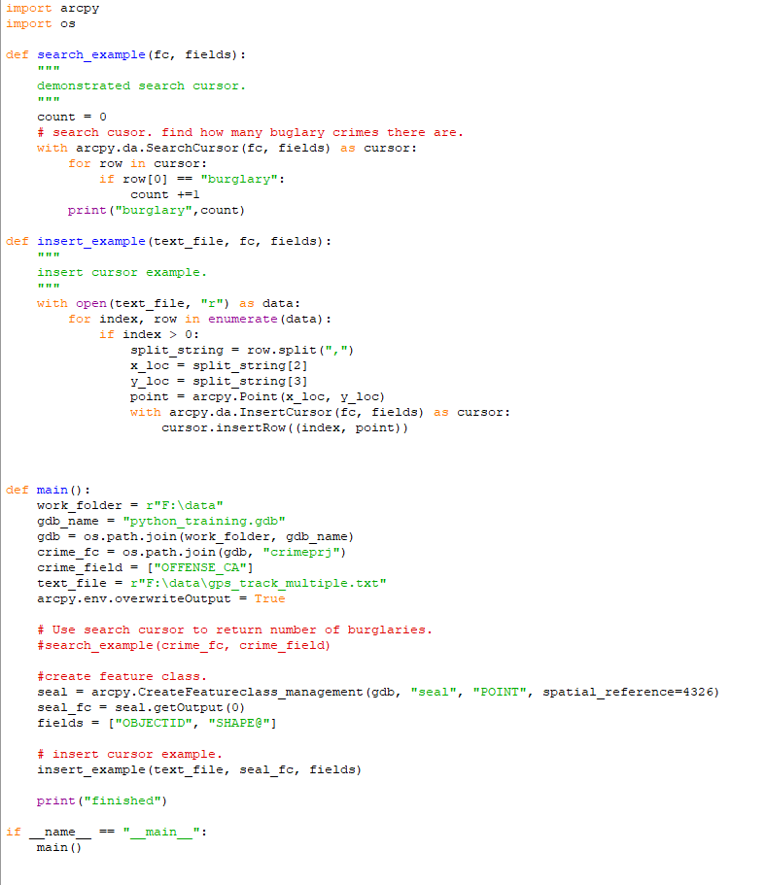

Slide 38
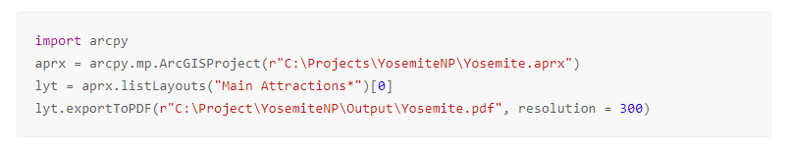
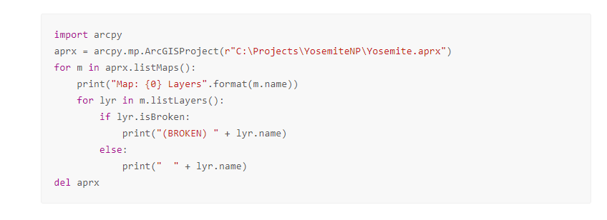
Mapping package
The arcpy.mp package is a way to programmatically modify ArcGIS Pro projects

Slide 39
Homework
Programing is like anything else it takes time and patience. I challenge each one of you to program at least 1 hour a week
Research has shown it takes about ten years to develop expertise in any of a wide variety of areas.
Everyone has taken this class for a reason, take what you have learned today and build on it
If you don’t have any programming problem to solve then look at Esri cursors, unit conversion, os module and sys module.
Look at functions and classes more.
Look into Git, virtualenv, virtualenvwrapper and Powershell

